Slide 1

Studying English Anticausative Constructions with the Help of LLMs
Laura Hahn
Quirin Würschinger
English Linguistics Colloquium
LMU Munich
4 July, 2024

Slide 2
What are Anticausatives?

Slide 3

He broke the window.
The window broke.

Slide 4
He broke the window.
The window broke.

Slide 5
He broke the window.
The window broke.

Slide 6
He broke the window.
The window broke.
*The window broke by him.

Slide 7
Anticausatives: | Relevant variable:
Are syntactically intransitive. | Syntactic transitivity
Have patient subjects that denote the same entities as the direct objects of the corresponding transitive patterns. | Subject role
Usually have inanimate subjects. | Subject animacy
Do not have an external causing agent in their syntactic structure and semantic frame. | Semantic transitivity
Have a non-causative (inchoative) meaning | ~Causativity

Slide 8
Why Study Anticausatives (with LLMs)?

Slide 9
Anticausatives have received considerable attention in typological as well as generative approaches to language (e.g. Alexiadou et al. 2006; Grewendorf 1989; Grimshaw 1982; Haspelmath 1987, 1993; Levin & Rappaport Hovav 1995; Schäfer 2008)
In English, both synchronic and diachronic corpus-based investigations are rare leaving many questions unanswered (but see e.g. García García and Ruiz Narbona 2021; Ingham 2020)
The construction has seen an increase in productivity over the past centuries and is a highly productive pattern in PDE (e.g. Halliday 1994; Keyser and Roeper 1984; McMillion 2006)

Slide 10
Problems with studying anticausatives in corpora:
English uses the same verb form in the transitive and intransitive pattern
Frequency of the anticausative construction compared to other uses of the same verb
Polysemy of verbs that show the alternation
Notes:
Screen ("to project onto/show on a screen") in COHA: 184 tokens overall, 23 anticausatives (12,5%), but 2100 screen tokens

Slide 11
How to Study Anticausatives with LLMs?

Slide 12
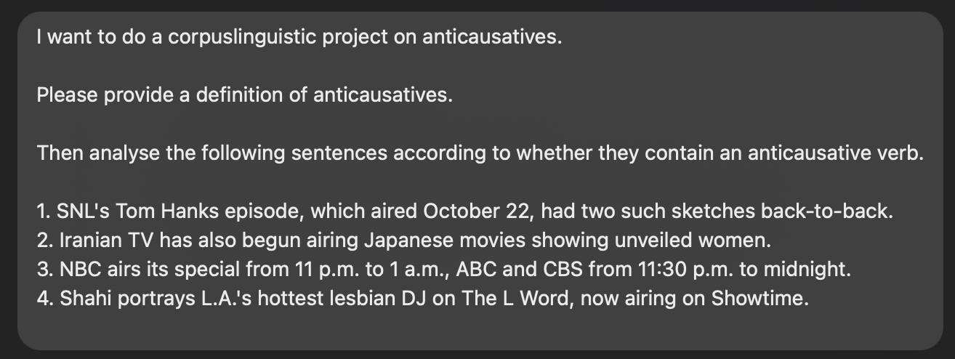
A first, naive human prompt
Notes:
If one were to use ChatGPT for corpuslinguistics for the first time.
4 examples: 2 causative, 2 anticausative

Slide 13
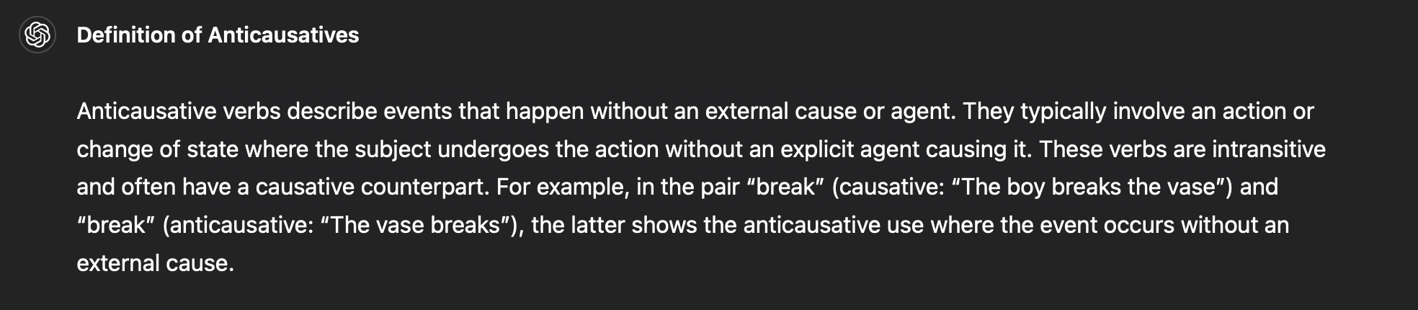
A first, naive LLM answer
Notes:
Not too bad
right
intransitive
example
but: focus on anticausativity of the event rather than the syntactical structure

Slide 14
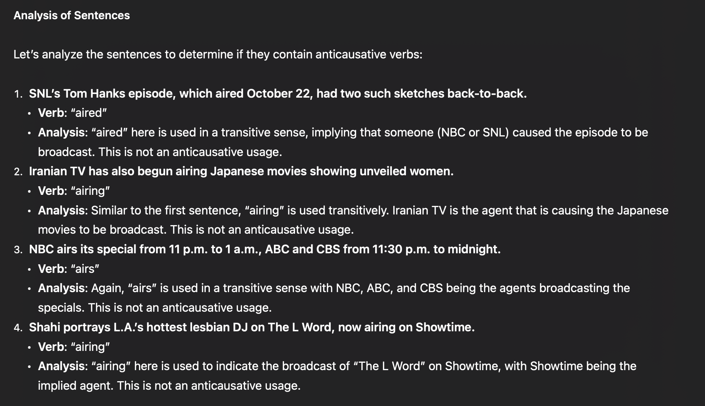
Notes:
anticausative
causative: object Japanese movies
causative: object special
anticausative

Slide 15
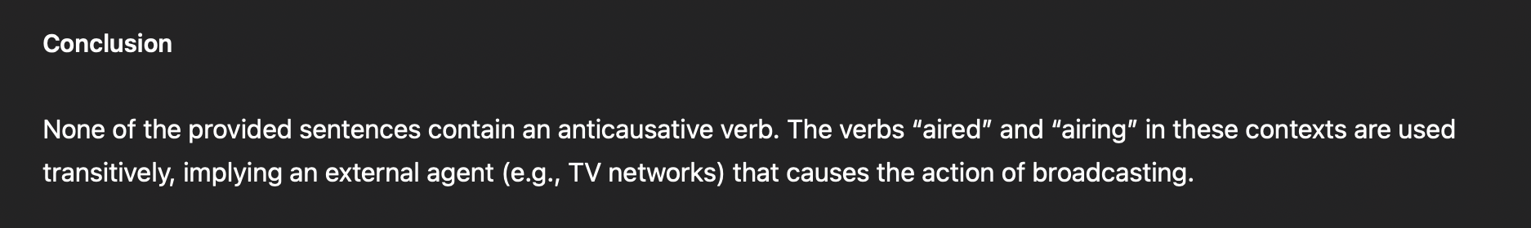
Notes:
incorrect according to Laura’s classification criteria
GPT cue: implied agent, causing event
linguistic cues: syntactic object and semantic frame (in the sentence structure)

Slide 16
Can LLMs be useful for linguists?
Empirical assessment
Practical advantages
Fonteyn (2024): successfully using BERT (precursor to GPT et al.) for word-sense disambiguation (metaphors) and semantic role labelling; also based on historical data.
Torrent (2024): detailed book “Copilots for Linguists”; successful application in the context of frame semantics.
Weissweiler (2024): identifying argument structure constructions with mixed success; cost-benefit analysis: humans vs machines.
Yu (2023): classifying pragmatic variables related to apology speech acts.
easy to use: “programming in English”
interpretable in the form of natural language feedback (controversial)
versatile
variables: formal & semantic
data formats: sentences, paragraphs, documents
scalable: big data & small cost
Notes:
a good way to view it: research assistant
weird: should not be trusted blindly
very diligent and patient
very consistent
practical advantages
“Software 2.0”
can give you verbal justifications (instead of model coefficients)
all kinds of variables: subject vs objects, animate vs inanimate, finding expressives or metaphors
can also used for discovering constructions: ”read these articles and find all passive constructions“
scalable: good for investigating rare phenomena (e.g. requests)

Slide 17

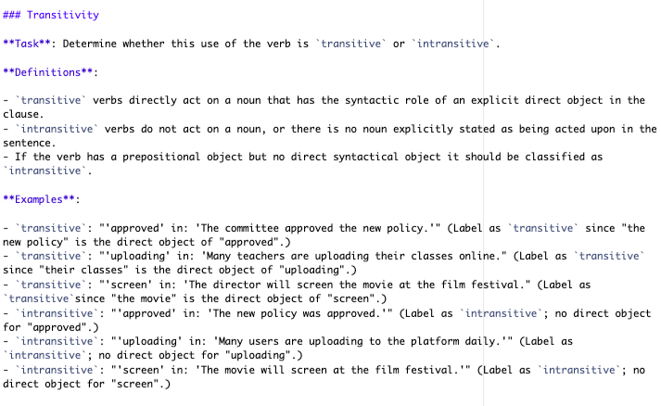
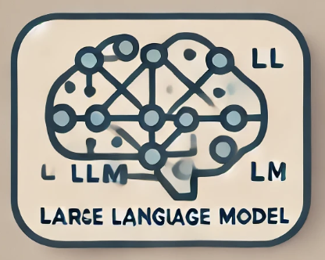
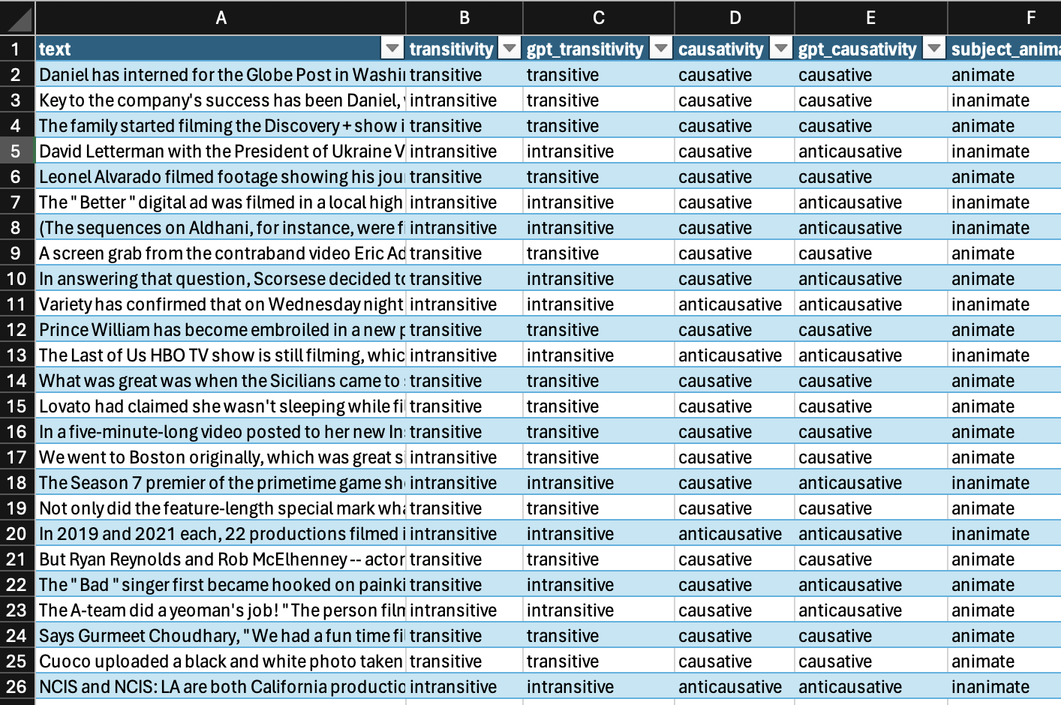
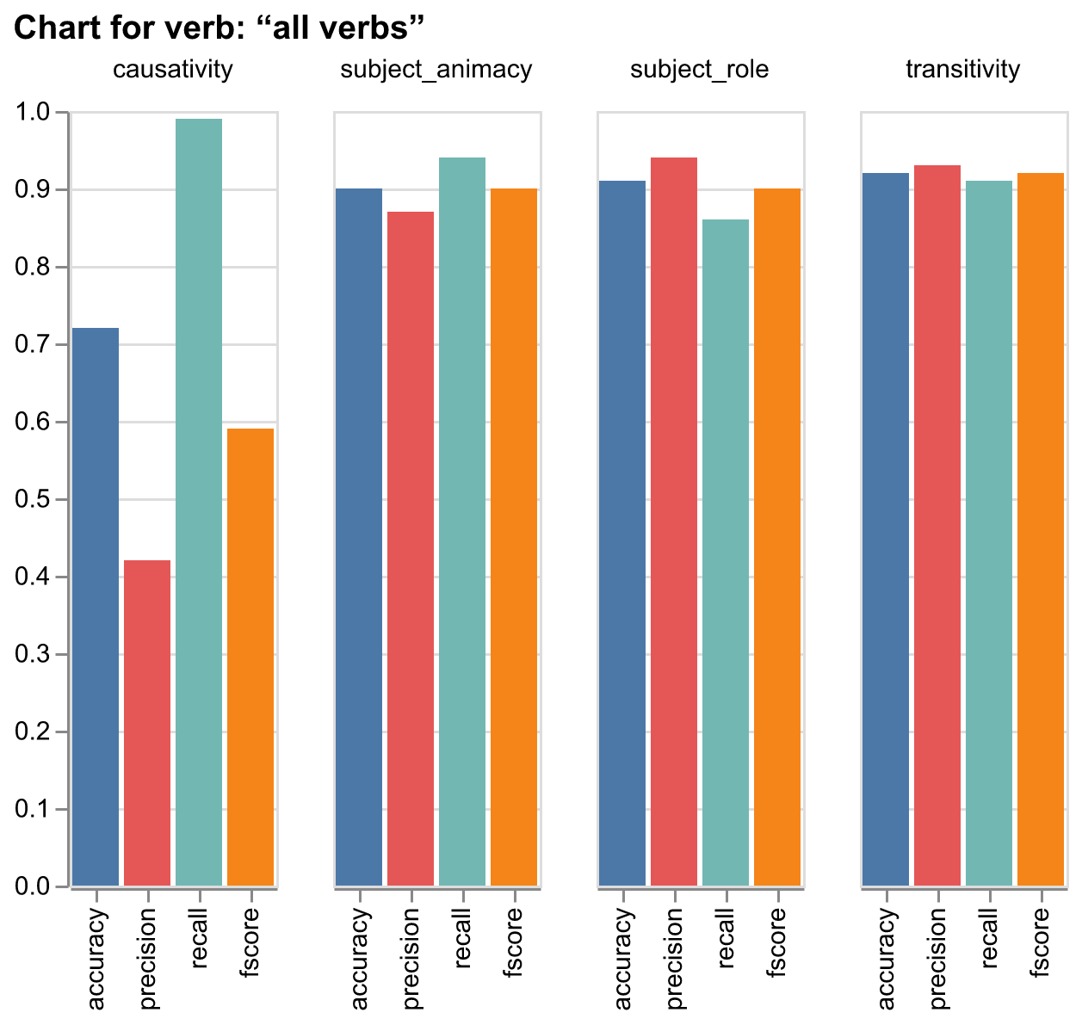
An iterative LLM Workflow
RQ
prompt
human-
labelled
sample
LLM
human-
labelled
sample
data
evaluation

Slide 18
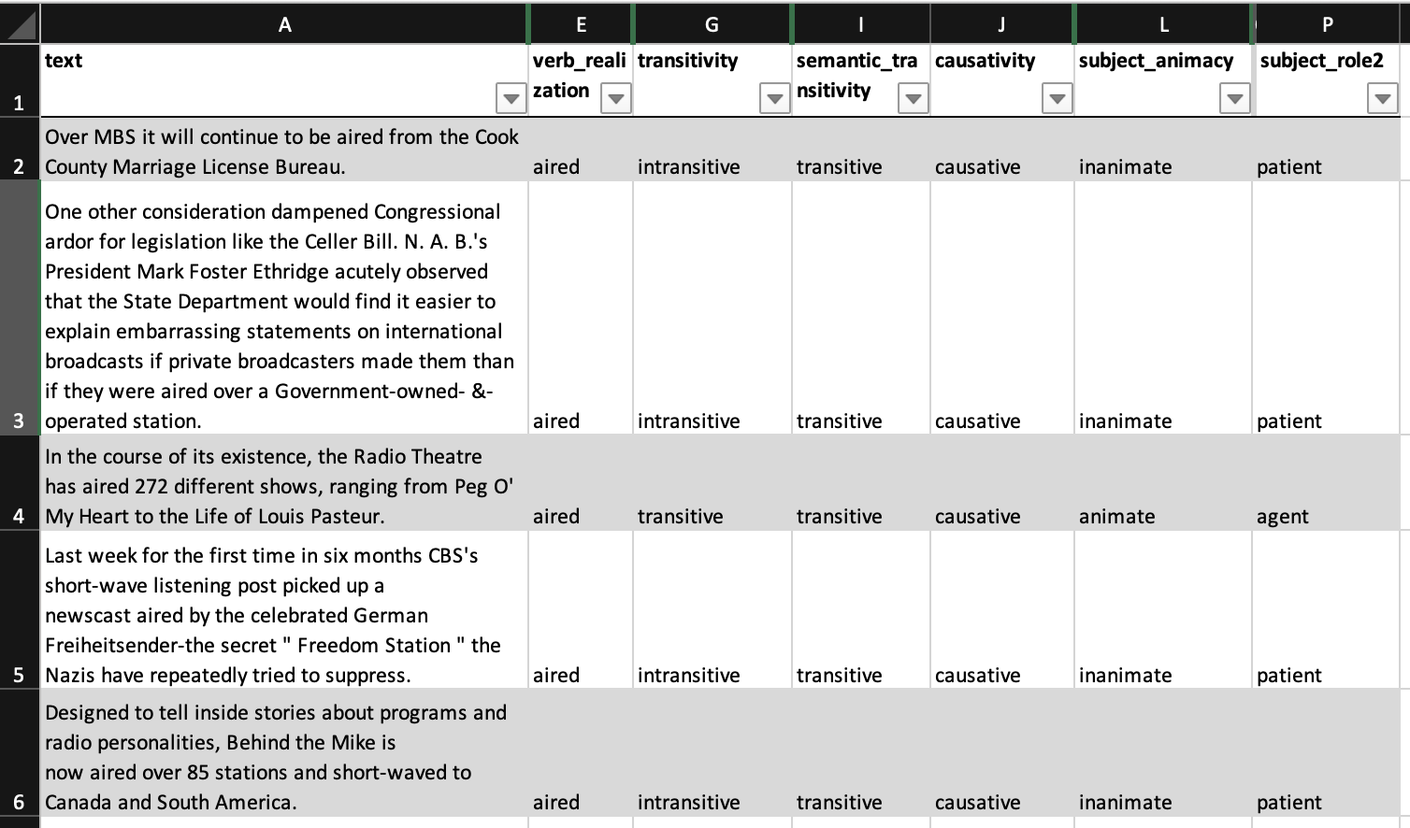
Input data
Notes:
coded by Laura
target variables
plus “verb_realization” to find target verb

Slide 19
LLM setup
model selection: GPT-4o by OpenAI currently best balance of cost/speed vs performance
prompt
task and role: “you’re a corpuslinguistic annotator, analyse verbs!”
for each variable: definition, labels, examples
instruction: “classify the verb <verb> in the utterance <utterance>”
specification for structured output (and input): variables and values

Slide 20
Prompting LLMs: an art rather than a science
Chain of Thought (CoT) prompting (Wei et al. 2022):
“think step by step”
encouraging reasoning over stream-of-consciousness
clear instructions
role: “corpuslinguistic annotator in research project”
specification of relevant concepts, variables, and values
few-shot examples with correct labels (Brown et al. 2020)
prototypical examples
borderline cases
previous misclassifications
function calling for structured output
Notes:
instructions: e.g. what is the target conception of “anticausative”
structured output: so far, not really possible using the standard web interface
best option: “format the results in csv format”
if Pro account: “let me download a csv file containing the results”

Slide 21
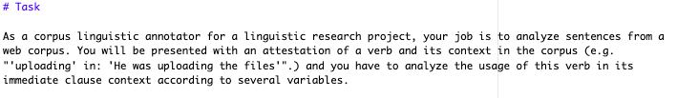
Prompt

Slide 22
Notes:
potential improvement: not noun, but syntactical direct object, since O_d could be pronouns or clauses

Slide 23
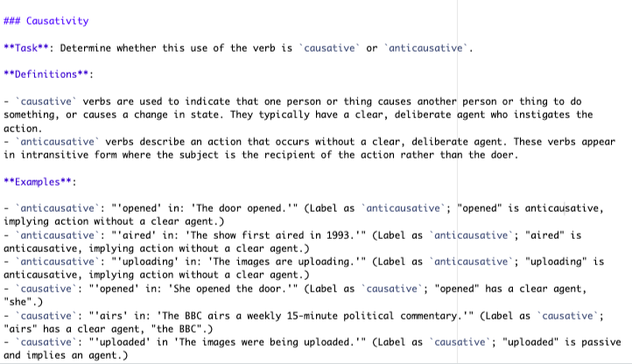

Slide 24
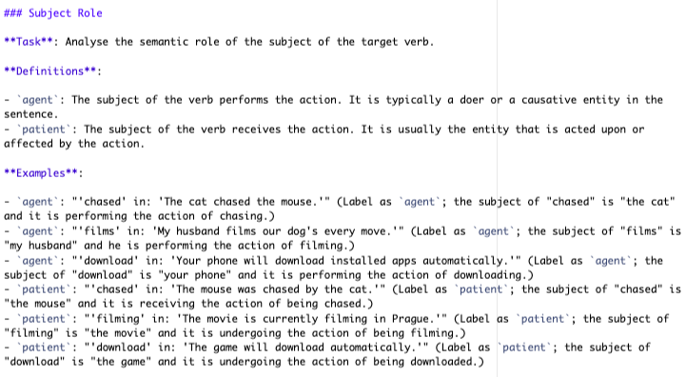

Slide 25
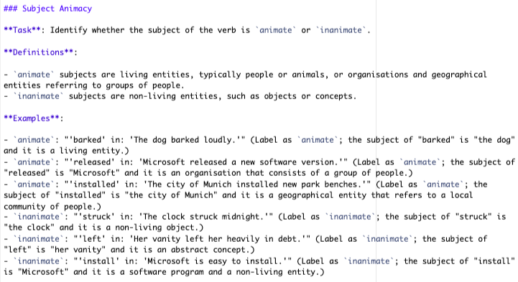

Slide 26
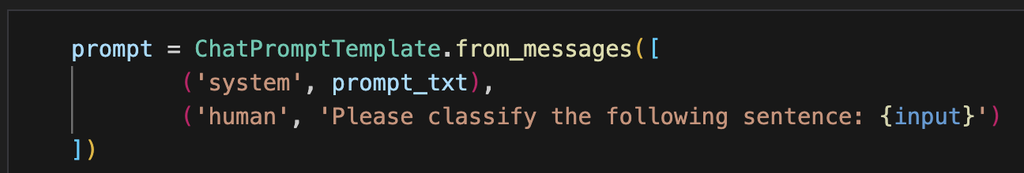
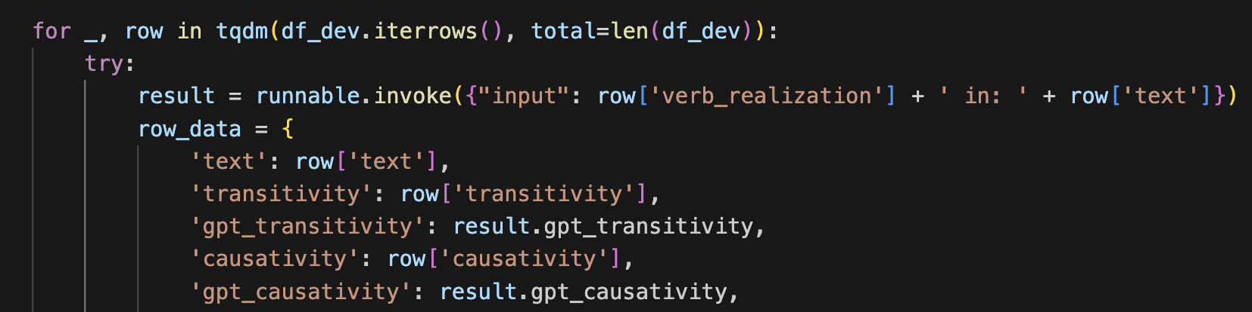
Starting the classification process

Slide 27
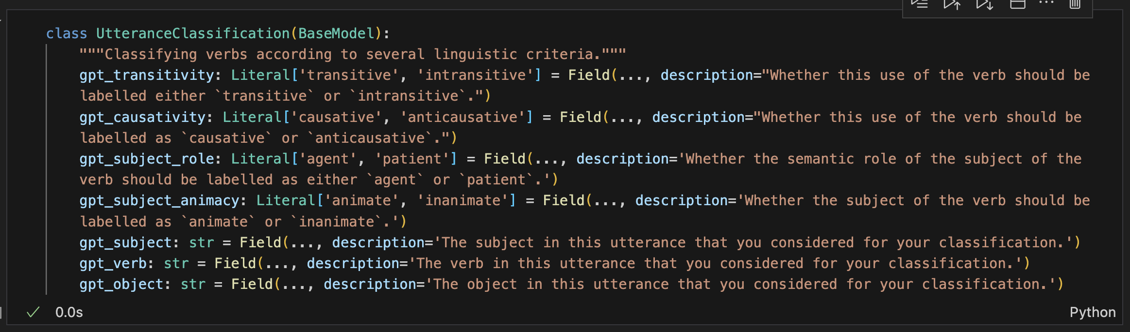
Variables specification for LLM

Slide 28
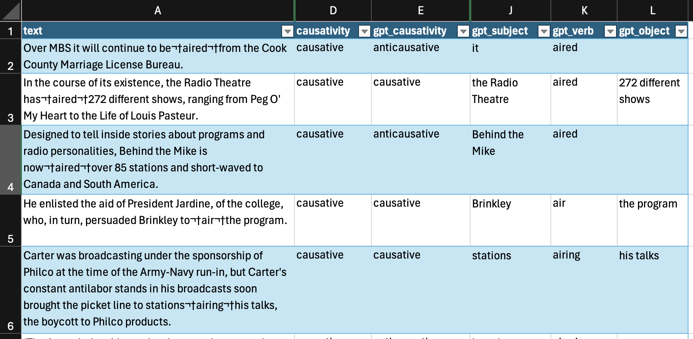
Classification output
Notes:
3 additional vars for investigating GPT’s behaviour
was the right verb analysed?
did GPT confuse syntactic vs semantic objects

Slide 29
Types of classification error/success
 | Predicted Positive | Predicted Negative
Actual Positive | True Positive Meanwhile, the last part of the Munich project is filming in Prague. And the show hadn't even aired yet. | False Negative It is airing five nights a week on cable's Turner Classic Movies.
Actual Negative | False Positive So this episode was screened for Lucas. She was just filming. Most broadway actors screen well […]. | True Negative Airrack had only uploaded 58 videos at that point. Download the mobile app.
Notes:
this is for classifying anticausatives
Laura vs GPT
annotating random samples is preferable
no GPT-based bias in pre-selection
getting a picture for False Negatives: what is missing?

Slide 30
Evaluation metrics
Accuracy is a measure of the model's overall correctness.
It is the ratio of correct predictions (both true positives and true negatives) to the total number of cases examined.
Precision measures the “accuracy” for the positive class.
It is the ratio of true positive predictions to the total number of positive predictions (both true and false positives).
Recall measures the coverage of the positive class.
It is the ratio of true positive predictions to the total number of actual positive instances
F1 score provides a balance of precision and recall.
It is the harmonic mean of precision and recall
Notes:
accuracy: in how many percent of cases did GPT decide correctly if anticausative?
not ideal in cases of unbalanced classes → often the case
e.g. anticausatives are of main interest, but rare → focus on this class
precision: among the predicted anticausatives, how many actually are anticausative?
recall: how many of all anticausatives did it catch?
F1: more sophisticated average of precision and recall

Slide 31
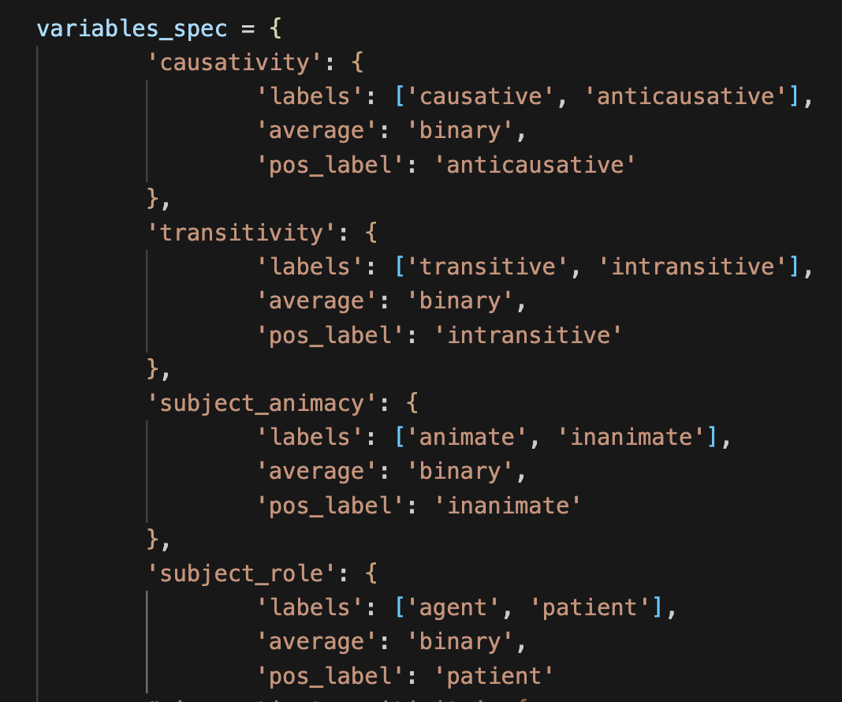
Variable specification
labels: the allowed values
average: binary vs multi-class classification problem
pos_label: the value of main interest
Notes:
4 variables of interest
checking whether all variables are present
checking whether all values are correct (e.g. no trailing spaces in Excel)
average: binary problem → for calculating precision and recall
`pos_label`: variable of main interest: e.g. anticausative
recall: how many anticausatives were detected

Slide 32
Results across all verbs
Variable | Class | Frequency
causativity | causative | 1104
 | anticausative | 280
subject animacy | animate | 680
 | inanimate | 704
subject role | agent | 736
 | patient | 648
transitivity | transitive | 689
 | Intransitive | 695

Slide 33
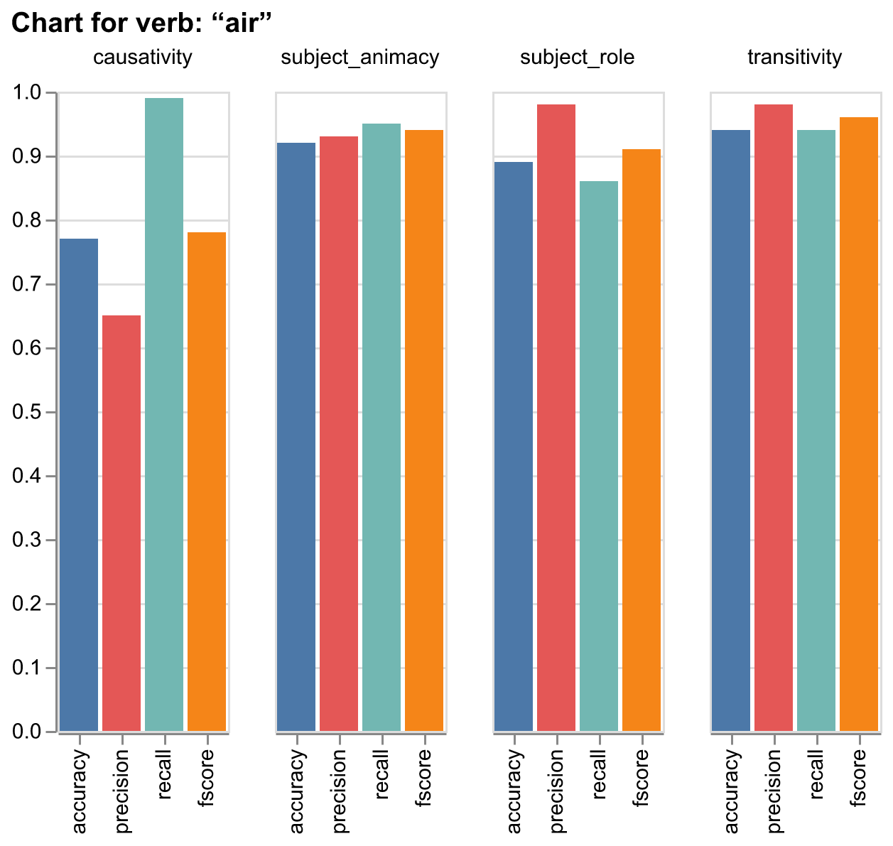
Results for the verb air
Variable | Class | Frequency
causativity | causative | 314
 | anticausative | 230
subject animacy | animate | 158
 | inanimate | 386
subject role | agent | 176
 | patient | 368
transitivity | transitive | 370
 | intransitive | 174

Slide 34
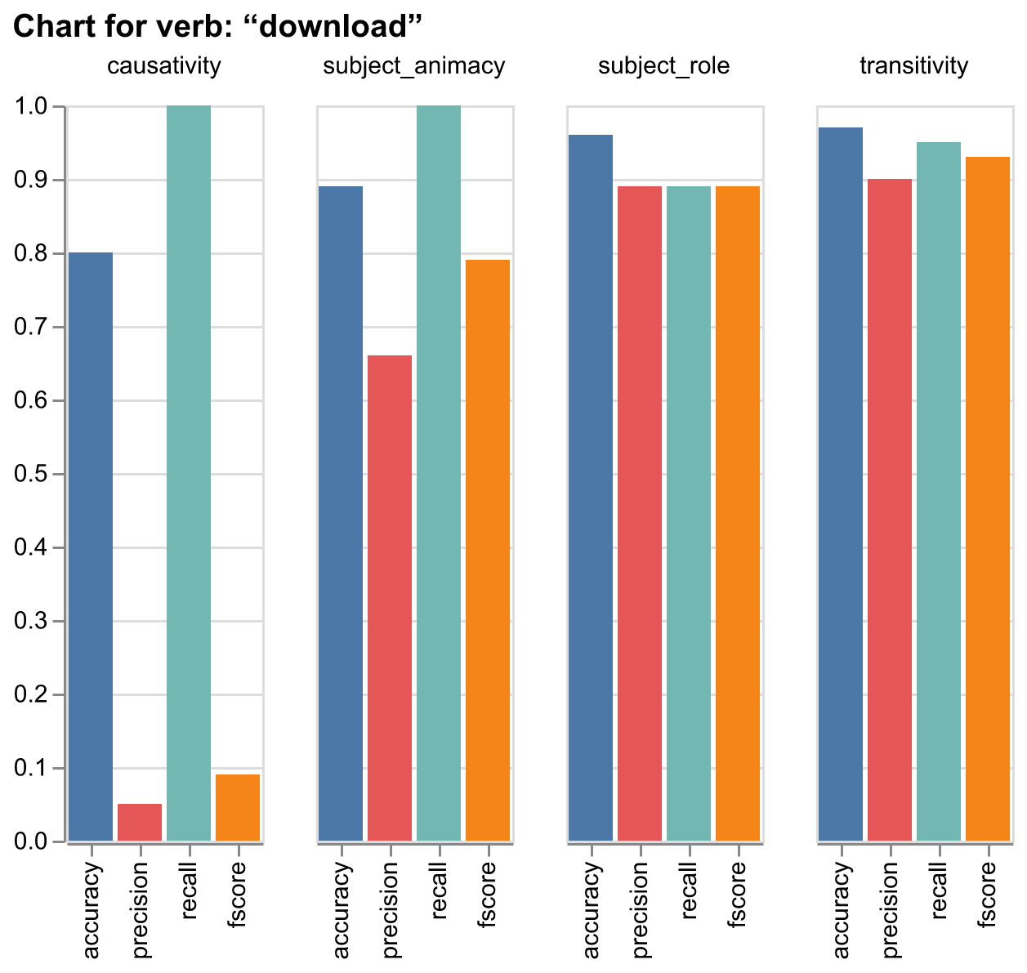
Results for the verb download
Variable | Class | Frequency
causativity | causative | 98
 | anticausative | 1
subject animacy | animate | 78
 | inanimate | 21
subject role | agent | 80
 | patient | 19
transitivity | transitive | 79
 | intransitive | 20

Slide 35
Conclusion and next steps
Overall, using LLMs for studying English anticausative shows promising initial results.
However, iterative improvement has been essential and there is still more to be done:
improving prompt for causativity variable
including semantic transitivity as a variable
deploying the LLM to discover anticausatives in unlabelled dataset
Maybe: trying other LLMs (e.g. Claude Sonnet 3.5)

Slide 36
References I
Alexiadou, Artemis, Elena Anagnostopoulou and Florian Schäfer. 2006. “The properties of anticausatives crosslinguistically”. Phases of Interpretation. Ed. Mara Frascarelli. Berlin/New York: Mouton de Gruyter. 187-211.
Brown, Tom, Benjamin Mann, Nick Ryder, Melanie Subbiah, Jared D Kaplan, Prafulla Dhariwal, Arvind Neelakantan, et al. 2020. ‘Language Models Are Few-Shot Learners’. In Advances in Neural Information Processing Systems, 33:1877–1901. Curran Associates, Inc. https://proceedings.neurips.cc/paper/2020/hash/1457c0d6bfcb4967418bfb8ac142f64a-Abstract.html.
García García, Luisa and Esaúl Ruiz Narbona. 2021. "Lability in Old English Verbs: Chronological and Textual Distribution". Anglia 139 (2): 283-36.
Grewendorf, Günther. 1989. Ergativity in German. Dordrecht: Foris.
Grimshaw, Jane. 1982. “On the lexical representation of Romance reflexive clitics”. The Mental Representation of Grammatical Relations. Ed. Joan Bresnan. Cambridge, MA: MIT Press. 87–148.
Fonteyn, Lauren, Enrique Manjavacas, Nina Haket, Aletta G. Dorst, and Eva Kruijt. 2024. ‘Could This Be next for Corpus Linguistics? Methods of Semi-Automatic Data Annotation with Contextualized Word Embeddings’. Linguistics Vanguard, June. https://doi.org/10.1515/lingvan-2022-0142.
Halliday, Michael A.K. 1994. An Introduction to Functional Grammar. London: Edward Arnold.
Haspelmath, Martin. 1987. Transitivity Alternations of the Anticausative Type. Cologne: Universität zu Köln.
Haspelmath, Martin. 1993. “More on the typology of inchoative/causative verb alternations”. Causatives and transitivity. Eds. Bernard Comrie & Maria Polinsky. Amsterdam/ Philadelphia: John Benjamins. 87-120

Slide 37
References II
Ingham, Richard. 2020. "How Contact with French Drove Patient-Lability in English". Transactions of the Phililogical Society 118 (3): 447–467.
Keyser, Samuel J. and Thomas Roeper. 1984. "On the Middle and Ergative Constructions in English." Linguistic Inquiry 15: 381-416.
Levin, Beth and Malka Rappaport Hovav. 1995. Unaccusativity: At the Syntax- Lexical Semantics Interface. Cambridge, MA: MIT Press.
McMillion, Alan. 2006. Labile Verbs in English: Their Meaning, Behaviour and Structure. PhD Thesis. Stockholm University: Department of Linguistics.
Schäfer, Florian. 2008. The Syntax of (Anti-)Causatives: External Arguments in Change-of-State Contexts. Amsterdam/ Philadelphia: John Benjamins.
Torrent, Tiago Timponi, Thomas Hoffmann, Arthur Lorenzi Almeida, and Mark Turner. 2023. ‘Copilots for Linguists: AI, Constructions, and Frames’. Elements in Construction Grammar, December. https://doi.org/10.1017/9781009439190.
Wei, Jason, Xuezhi Wang, Dale Schuurmans, Maarten Bosma, Brian Ichter, Fei Xia, Ed Chi, Quoc V. Le, and Denny Zhou. 2022. ‘Chain-of-Thought Prompting Elicits Reasoning in Large Language Models’. Advances in Neural Information Processing Systems 35 (December):24824–37.
Weissweiler, Leonie, Abdullatif Köksal, and Hinrich Schütze. 2024. ‘Hybrid Human-LLM Corpus Construction and LLM Evaluation for Rare Linguistic Phenomena’. arXiv. https://doi.org/10.48550/arXiv.2403.06965.
Yu, Danni, Luyang Li, and Hang Su. 2023. ‘Using LLM-Assisted Annotation for Corpus Linguistics: A Case Study of Local Grammar Analysis’. arXiv. https://doi.org/10.48550/arXiv.2305.08339.

Slide 38
Appendix

Slide 39
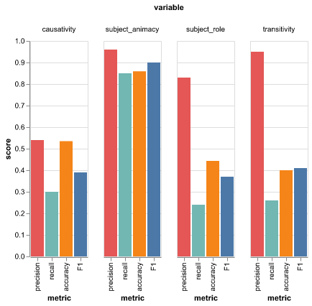
Results from February: mixed success

